Slide 1
Lecture 11. Elliptic Curve Cryptography
CSE 1204 Applied Cryptography
Lectures by Zhaxalykov T.M.

Slide 2
Agenda
Introduction to Elliptic Curves
Elliptic Curve Mathematics
Elliptic Curves over Finite Fields
ECDH: Elliptic Curve Diffie-Hellman
ECDSA: Elliptic Curve Digital Signatures
Modern Curves and Standards

Slide 3
1. Introduction to Elliptic Curves
1.1 Why Elliptic Curves?
1.2 ECC Advantages
1.3 Elliptic Curve Definition

Slide 4
1. Introduction to Elliptic Curves
Elliptic Curve Cryptography (ECC), independently proposed by Neal Koblitz and Victor Miller in 1985, provides an alternative mathematical foundation for public key cryptography with remarkable efficiency advantages.

Slide 5
1.1 Why Elliptic Curves?
Traditional public key systems (RSA, DH) rely on integer factorization or discrete logarithm problems. These have subexponential-time algorithms (General Number Field Sieve), requiring increasingly large keys for security.
Elliptic curves offer a crucial advantage: the best known attacks are fully exponential (Pollard's rho), meaning smaller keys provide equivalent security.

Slide 6
Example 1.1: Key Size Comparison
Security Level (Symmetric equivalent) | RSA / DH (bits) | ECC (bits) | Ratio (RSA:ECC)
80-bit | 1024 | 160 | 6.4×
112-bit | 2048 | 224 | 9.1×
128-bit | 3072 | 256 | 12×
192-bit | 7680 | 384 | 20×
256-bit | 15360 | 512 | 30×
A 256-bit ECC key provides equivalent security to a 3072-bit RSA key—12× smaller!

Slide 7
1.2 ECC Advantages
Smaller Keys: 10-30× smaller than RSA for equivalent security
Faster Computation: Especially for key generation and signing
Less Bandwidth: Smaller keys and signatures reduce transmission costs
Lower Power: Ideal for mobile devices, IoT, embedded systems
Stronger Security: No subexponential algorithms known

Slide 8
1.3 Elliptic Curve Definition
Definition 1.1 (Elliptic Curve): An elliptic curve over real numbers ℝ is the set of points (x, y) satisfying the Weierstrass equation: y² = x³ + ax + b, together with a special point O (point at infinity), where the discriminant Δ = 4a³ + 27b² ≠ 0 (ensures non-singular curve).
The curve forms a smooth, continuous shape with no cusps, self-intersections, or isolated points.

Slide 9
Example 1.2: Elliptic Curve Visualization
Curve: y² = x³ - x + 1
Parameters: a = -1, b = 1
Discriminant: Δ = 4(-1)³ + 27(1)² = -4 + 27 = 23 ≠ 0 ✓
Valid elliptic curve (symmetric about x-axis)

Slide 10
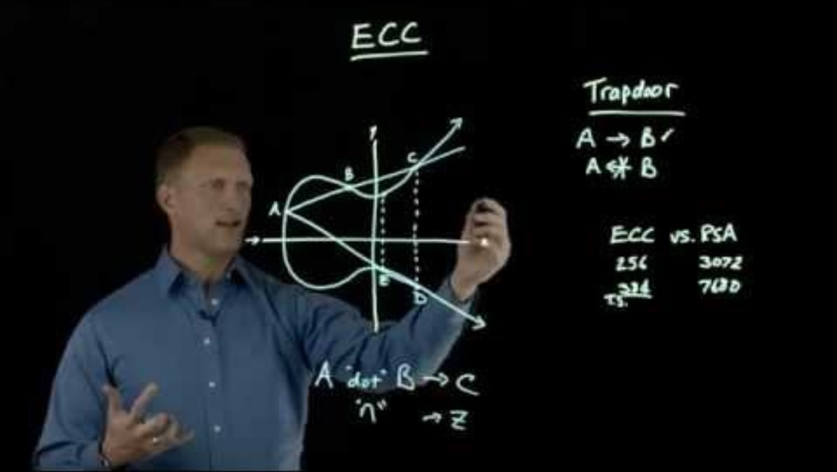

Slide 11
2. Elliptic Curve Mathematics
2.1 Point Addition: Geometric Interpretation
2.2 Group Properties
2.3 Point Addition Formulas
2.4 Scalar Multiplication

Slide 12
2. Elliptic Curve Mathematics
Elliptic curves form an abelian group under a geometric point addition operation.

Slide 13
2.1 Point Addition: Geometric Interpretation
To add two points P and Q on the curve:
Draw a line through P and Q
This line intersects the curve at a third point R'
Reflect R' across the x-axis to get R = P + Q
This geometric construction ensures closure: the result is always on the curve.

Slide 14
2.2 Group Properties
Identity Element: Point at infinity O. For any point P: P + O = P
Inverse Element: For P = (x, y), the inverse is -P = (x, -y). Property: P + (-P) = O
Associativity: (P + Q) + R = P + (Q + R)
Commutativity: P + Q = Q + P

Slide 15
2.3 Point Addition Formulas
Case 1: P ≠ Q (Different Points)
Given: P = (x₁, y₁), Q = (x₂, y₂)
Slope: λ = (y₂ - y₁) / (x₂ - x₁)
Result R = (x₃, y₃):
x₃ = λ² - x₁ - x₂
y₃ = λ(x₁ - x₃) - y₁

Slide 16
2.3 Point Addition Formulas
Case 2: P = Q (Point Doubling)
Given: P = (x₁, y₁)
Slope (tangent): λ = (3x₁² + a) / (2y₁)
Result R = 2P = (x₃, y₃):
x₃ = λ² - 2x₁
y₃ = λ(x₁ - x₃) - y₁

Slide 17
Example 2.1: Point Addition on Real Curve
Curve: y² = x³ - x + 1
P = (0, 1), Q = (1, 1)
Compute R = P + Q:
λ = (1 - 1)/(1 - 0) = 0
x₃ = 0² - 0 - 1 = -1
y₃ = 0(0 - (-1)) - 1 = -1
R = (-1, -1)
Verify: (-1)² = (-1)³ - (-1) + 1 → 1 = -1 + 1 + 1 → 1 = 1 ✓

Slide 18
2.4 Scalar Multiplication
Definition 2.1 (Scalar Multiplication): For point P and integer n, scalar multiplication is nP = P + P + ... + P (n times).
Efficient Computation: Double-and-Add Algorithm
Similar to repeated squaring for modular exponentiation. Convert n to binary, process bits using doubling and conditional addition.

Slide 19
Example 2.2: Scalar Multiplication
Compute 11P using double-and-add:
11 in binary: 1011₂
Process bits right-to-left:
Bit 0 (1): Result = P
Bit 1 (1): Result = 2(P) + P = 3P
Bit 2 (0): Result = 2(3P) = 6P
Bit 3 (1): Result = 2(6P) + P = 13P... (adjust)
Requires: 3 doublings + 2 additions (5 ops vs 10 for naive)

Slide 20
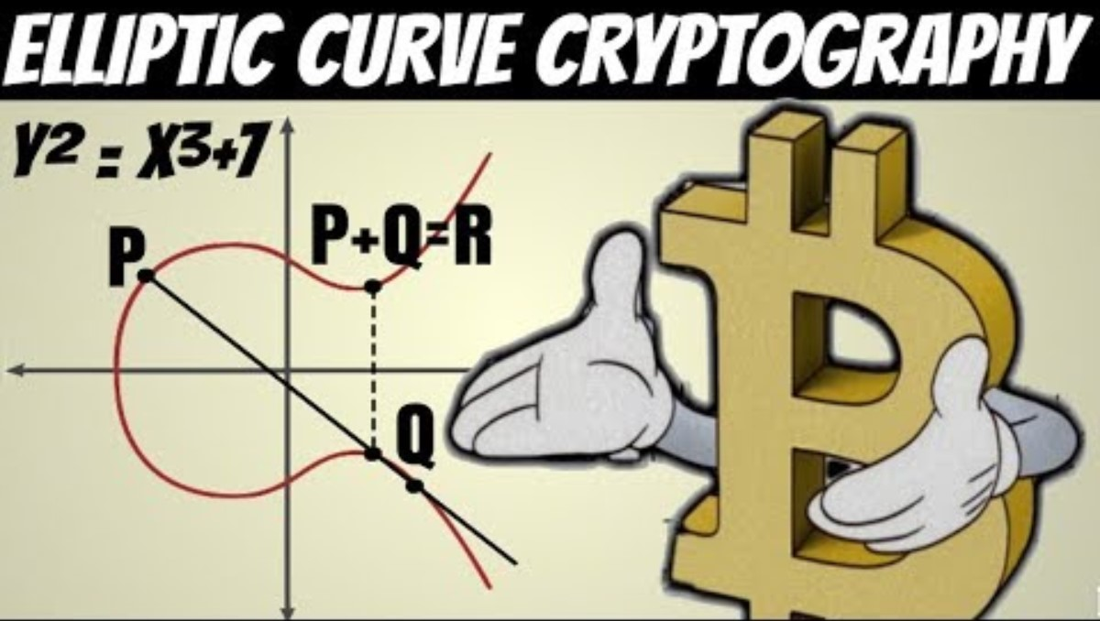

Slide 21
3. Elliptic Curves over Finite Fields
3.1 Definition
3.2 Point Addition over Finite Fields
3.3 Group Order and Hasse's Theorem
3.4 The ECDLP (Elliptic Curve Discrete Logarithm Problem)

Slide 22
3. Elliptic Curves over Finite Fields
For cryptography, we use elliptic curves over finite fields 𝔽ₚ (integers mod p) instead of real numbers.

Slide 23
3.1 Definition
Definition 3.1 (EC over Finite Field): An elliptic curve E over 𝔽ₚ (prime p > 3) is: E(𝔽ₚ) = {(x, y) ∈ 𝔽ₚ × 𝔽ₚ : y² ≡ x³ + ax + b (mod p)} ∪ {O}, where 4a³ + 27b² ≢ 0 (mod p).
All arithmetic (addition, multiplication, division) performed modulo p.

Slide 24
Example 3.1: Finding Points on Finite Curve
Curve: y² = x³ + x + 1 over 𝔽₅
Parameters: p = 5, a = 1, b = 1
Test all x ∈ {0,1,2,3,4}:
x=0: y² ≡ 0+0+1 ≡ 1 → y ∈ {1,4} → Points: (0,1), (0,4)
x=1: y² ≡ 1+1+1 ≡ 3 → No square root mod 5
x=2: y² ≡ 8+2+1 ≡ 11 ≡ 1 → y ∈ {1,4} → Points: (2,1), (2,4)
x=3: y² ≡ 27+3+1 ≡ 31 ≡ 1 → y ∈ {1,4} → Points: (3,1), (3,4)
x=4: y² ≡ 64+4+1 ≡ 69 ≡ 4 → y ∈ {2,3} → Points: (4,2), (4,3)
Total: 8 points + O = 9 points (order of curve)

Slide 25
3.2 Point Addition over Finite Fields
Formulas same as real curves, but with modular arithmetic:
λ = (y₂ - y₁) × (x₂ - x₁)⁻¹ mod p (for P ≠ Q)
λ = (3x₁² + a) × (2y₁)⁻¹ mod p (for P = Q)
Division replaced by multiplication with modular inverse.

Slide 26
Example 3.2: Point Addition over 𝔽₂₃
Curve: y² = x³ + x + 1 over 𝔽₂₃
P = (0, 1), Q = (3, 10)
Compute R = P + Q:
λ = (10 - 1) × (3 - 0)⁻¹ mod 23
= 9 × 3⁻¹ mod 23
= 9 × 8 mod 23 (since 3 × 8 = 24 ≡ 1 mod 23)
= 72 mod 23 = 3
x₃ = 3² - 0 - 3 mod 23 = 6
y₃ = 3(0 - 6) - 1 mod 23 = -19 mod 23 = 4
R = (6, 4)

Slide 27
3.3 Group Order and Hasse's Theorem
Theorem 3.1 (Hasse's Theorem): For elliptic curve E over 𝔽ₚ, let N = |E(𝔽ₚ)| be the number of points. Then: p + 1 - 2√p ≤ N ≤ p + 1 + 2√p
This bounds the curve order near p, ensuring large group for cryptographic use.

Slide 28
3.4 The ECDLP (Elliptic Curve Discrete Logarithm Problem)
Definition 3.2 (ECDLP): Given elliptic curve E over 𝔽ₚ, base point G of order n, and point Q = nG, find integer k (0 ≤ k < n) such that Q = kG.
Best Known Algorithm: Pollard's rho algorithm
Complexity: O(√n) ≈ O(2^(m/2)) for m-bit curve
Fully exponential—no subexponential algorithm known!
This is why ECC offers better security-per-bit than RSA/DH.

Slide 29
3. Elliptic Curves over Finite Fields
For cryptography, we use elliptic curves over finite fields 𝔽ₚ (integers mod p) instead of real numbers.

Slide 30
4. ECDH: Elliptic Curve Diffie-Hellman
4.1 ECDH Protocol
4.2 X25519: Modern ECDH

Slide 31
4. ECDH: Elliptic Curve Diffie-Hellman
ECDH adapts Diffie-Hellman key exchange to elliptic curves, providing equivalent security with much smaller keys.

Slide 32
4.1 ECDH Protocol
Public Parameters (Domain Parameters):
Elliptic curve E over 𝔽ₚ: y² = x³ + ax + b
Base point G ∈ E(𝔽ₚ)
Order n of G (prime, satisfying nG = O)

Slide 33
Protocol Execution:
Alice:
1. Choose random private key a (1 ≤ a < n)
2. Compute public key A = aG
3. Send A to Bob
Bob:
1. Choose random private key b (1 ≤ b < n)
2. Compute public key B = bG
3. Send B to Alice
Shared Secret:
Alice computes: K = aB = a(bG) = (ab)G
Bob computes: K = bA = b(aG) = (ab)G
Both derive same point K = (ab)G. Use x-coordinate as shared secret.

Slide 34
Example 4.1: Small ECDH Exchange
Curve: y² = x³ + x + 1 over 𝔽₂₃
Base point: G = (0, 1), order n = 24
Alice: a = 5 (private)
A = 5G = (6, 4) (public)
Bob: b = 7 (private)
B = 7G = (13, 10) (public)
Alice: K = 5B = 5(13, 10) = (18, 20)
Bob: K = 7A = 7(6, 4) = (18, 20)
Shared secret: x-coordinate = 18 ✓

Slide 35
4.2 X25519: Modern ECDH
X25519 is ECDH using Curve25519, designed by Daniel J. Bernstein in 2005.
Key Features:
Montgomery Curve: Different form than Weierstrass, optimized for DH
255-bit Prime: p = 2²⁵⁵ - 19
X-coordinate Only: Faster computation (no y-coordinate needed)
Constant-Time: Resistant to timing attacks
Fast: ~100,000 operations/second on modern CPU
Deployment: Signal Protocol, WhatsApp, WireGuard VPN, TLS 1.3, OpenSSH, age encryption tool

Slide 36
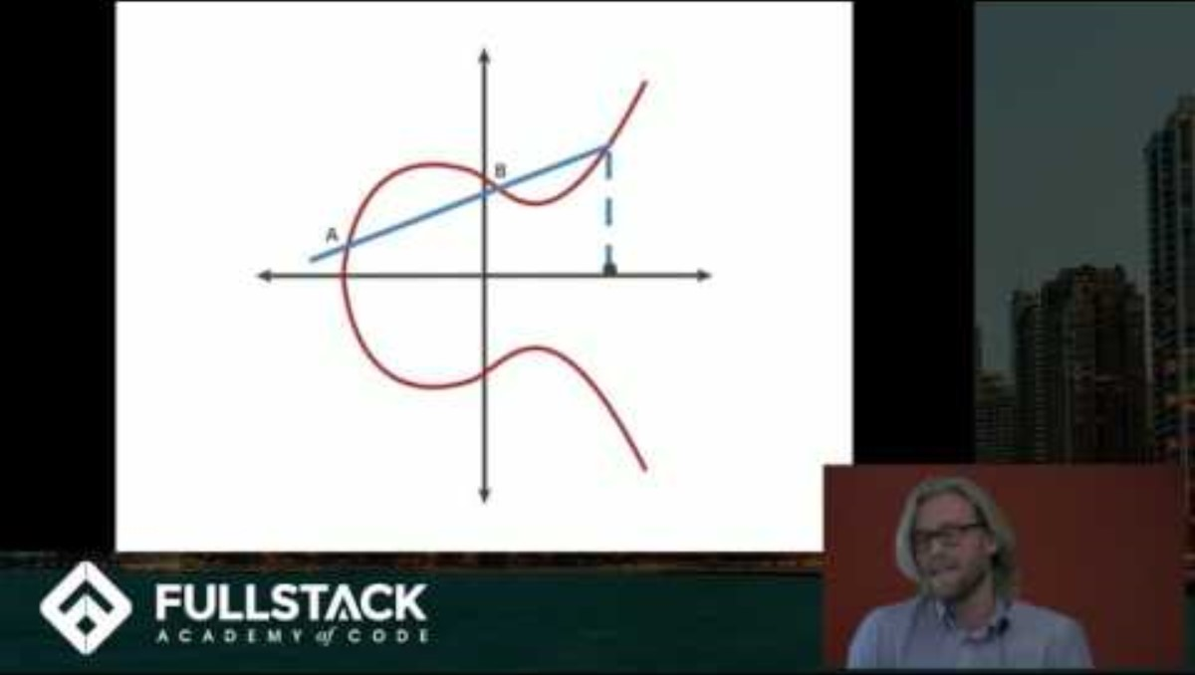

Slide 37
5. ECDSA: Elliptic Curve Digital Signatures
5.1 ECDSA Algorithm
5.2 Critical Security Requirement
5.3 EdDSA: Modern Alternative
5.4 Ed25519: EdDSA with Curve25519

Slide 38
5. ECDSA: Elliptic Curve Digital Signatures
ECDSA is the elliptic curve analog of DSA, providing digital signatures with smaller keys.

Slide 39
5.1 ECDSA Algorithm
Key Generation:
Select curve E, base point G of order n
Choose random private key d (1 ≤ d < n)
Compute public key Q = dG
Signing Message M:
Compute message hash: e = H(M) (typically SHA-256)
Choose random ephemeral key k (1 ≤ k < n)
Compute (x₁, y₁) = kG
Compute r = x₁ mod n (if r = 0, choose new k)
Compute s = k⁻¹(e + dr) mod n (if s = 0, choose new k)
Signature: (r, s)
Verification:
Verify 1 ≤ r, s < n
Compute e = H(M)
Compute w = s⁻¹ mod n
Compute u₁ = ew mod n, u₂ = rw mod n
Compute (x₁, y₁) = u₁G + u₂Q
Accept if r ≡ x₁ (mod n)

Slide 40
5.2 Critical Security Requirement
WARNING: The ephemeral key k must be unique per signature and truly random. Reusing k or using predictable k allows private key recovery!

Slide 41
Example 5.1: Nonce Reuse Attack
If two signatures (r₁, s₁) and (r₂, s₂) use same k:
r₁ = r₂ (reveals k reuse!)
s₁ = k⁻¹(e₁ + dr₁) mod n
s₂ = k⁻¹(e₂ + dr₂) mod n
s₁ - s₂ = k⁻¹(e₁ - e₂) mod n
k = (e₁ - e₂)(s₁ - s₂)⁻¹ mod n
d = (s₁k - e₁)r₁⁻¹ mod n ← PRIVATE KEY RECOVERED!

Slide 42
Example 5.2: Sony PlayStation 3 Hack (2010)
Sony's PS3 firmware signing implementation used ECDSA with a constant value for k (catastrophic error). Researchers analyzed two PS3 firmware signatures, noticed identical r values, computed k, then recovered Sony's private signing key.
Impact: Anyone could sign arbitrary PS3 firmware and executables. Complete security compromise. Sony had to issue hardware revisions.

Slide 43
5.3 EdDSA: Modern Alternative
EdDSA (Edwards-curve Digital Signature Algorithm) addresses ECDSA's weaknesses:
Key Improvements:
Deterministic Nonces: k = H(hash_prefix || private_key || message) (RFC 6979). No randomness needed!
Simpler Algorithm: Fewer edge cases, easier to implement correctly
Faster: Especially signature generation
Better Provable Security: Stronger security proofs
Side-Channel Resistant: Designed for constant-time implementation

Slide 44
5.4 Ed25519: EdDSA with Curve25519
Ed25519 is EdDSA using Curve25519 in twisted Edwards form.
Specifications:
Signature size: 64 bytes (512 bits)
Public key size: 32 bytes (256 bits)
Private key size: 32 bytes (256 bits)
Security: ~128-bit
Performance:
Signing: ~20,000 signatures/second
Verification: ~7,000 verifications/second
Deployment: OpenSSH (default since 2014), Signal Protocol, Tor, DNSSEC, Monero cryptocurrency, ZCash, Tezos

Slide 45
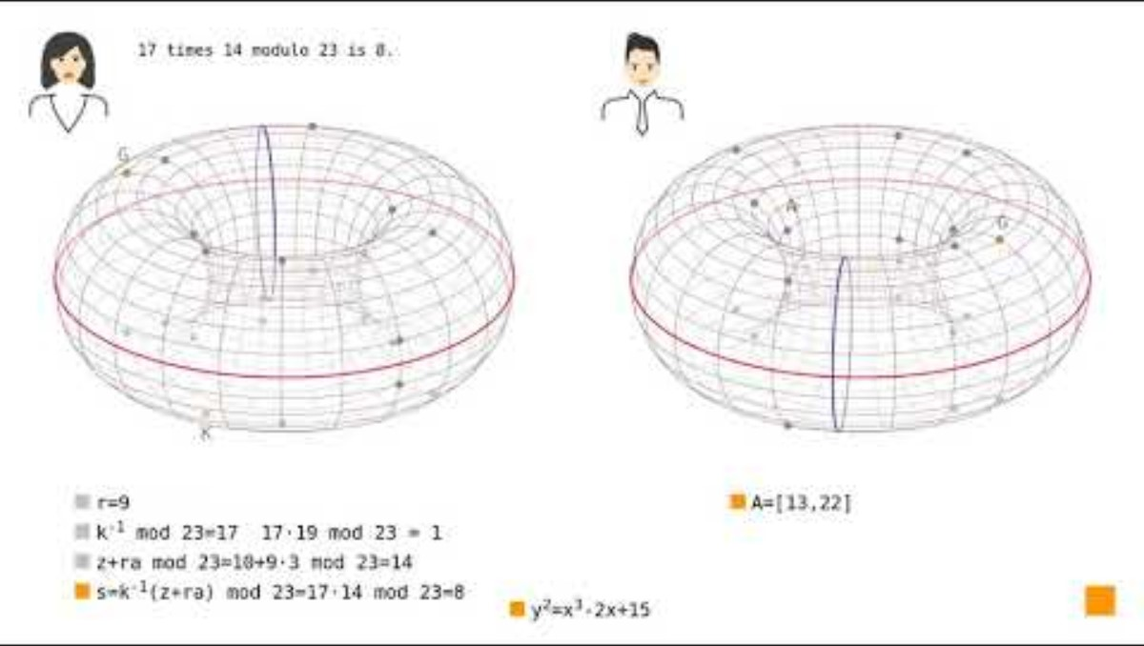

Slide 46
6. Modern Curves and Standards
6.1 NIST Standard Curves
6.2 Modern Safe Curves
6.3 Performance Comparison
6.4 Curve Selection Guide
6.5 Implementation Pitfalls

Slide 47
6.1 NIST Standard Curves
NIST standardized curves in FIPS 186-4:
P-256 (secp256r1):
256-bit prime field, ~128-bit security
Most widely deployed ECC curve
Used in: TLS, Bitcoin, SSH, many smart cards
P-384 (secp384r1): 384-bit, ~192-bit security. High security applications.
P-521 (secp521r1): 521-bit, ~260-bit security. Maximum security (note: 521 not 512!).

Slide 48
6.2 Modern Safe Curves
Curve25519:
Designed by Daniel J. Bernstein (2005)
Montgomery curve: By² = x³ + Ax² + x over 𝔽ₚ where p = 2²⁵⁵ - 19
255-bit field, ~128-bit security
Optimized for performance and security
Constant-time by design (no conditional branches)
No known patent issues
Curve448 (Goldilocks): 448-bit, ~224-bit security. Extra security margin. Designed by Mike Hamburg.

Slide 49
6.3 Performance Comparison
Operation | RSA-2048 | NIST P-256 (ECC) | Curve25519 (ECC)
Key Generation | ~200 ms | ~0.5 ms | ~0.05 ms
ECDH / Sign | ~0.8 ms | ~0.5 ms | ~0.05 ms
Verify | ~0.05 ms | ~1 ms | ~0.1 ms
Key Size | 2048 bit | 256 bit | 256 bit
ECC generally 10-30× faster than RSA, especially on embedded devices.

Slide 50
6.4 Curve Selection Guide
For New Implementations:
First Choice: Curve25519/Ed25519 (X25519 for ECDH, Ed25519 for signatures)
Standards Compliance: P-256 (required for FIPS, government systems)
Extra Security: P-384, P-521, or Curve448
Avoid:
Non-standard or proprietary curves (potential backdoors)
Curves with small security margin (P-192, secp160r1)
Binary field curves (less efficient, more complex)

Slide 51
6.5 Implementation Pitfalls
Point Validation: Always verify received points are on the curve (prevents invalid-curve attacks)
Timing Attacks: Use constant-time implementations (no data-dependent branches)
Nonce Generation: Use deterministic k (EdDSA/RFC 6979) or cryptographic-quality randomness
Side Channels: Protect against power analysis, cache-timing attacks
Library Choice: Use well-audited libraries: libsodium, OpenSSL 3.x, BoringSSL, wolfSSL

Slide 52
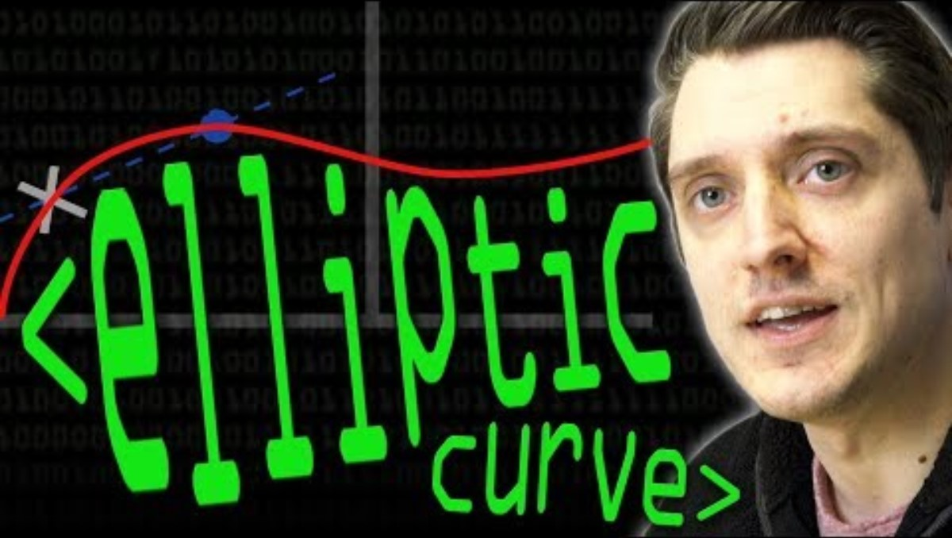

Slide 53
Conclusion
This lecture covered elliptic curve cryptography from mathematical foundations to practical implementations. Key insights:
Elliptic curves provide equivalent security with 10-30× smaller keys than RSA/DH
ECDLP has no known subexponential algorithm (unlike factoring/DLP)
Point addition and scalar multiplication form abelian group structure
ECDH enables efficient key exchange with 256-bit keys
ECDSA provides digital signatures but requires unique nonces (Sony PS3 lesson)
Ed25519/EdDSA fixes ECDSA issues with deterministic nonces
Curve25519 is recommended for new applications (Signal, WireGuard, TLS 1.3)
P-256 required for FIPS compliance and government systems
Implementation requires care: constant-time ops, point validation, proper nonces

Slide 54
Looking Forward
Next Section (Weeks 12-14): Quantum Cryptography and Post-Quantum Cryptography. We will study quantum key distribution (QKD), BB84 protocol, quantum threats to current cryptography, NIST post-quantum standards (lattice-based, hash-based, code-based cryptography).

Slide 55
7.2 Preparation
Read: Introduction to Quantum Cryptography (Thomas Vidick & Stephanie Wehner)
Review: Quantum mechanics basics (superposition, entanglement, measurement)
Lab 3: Implement ECDH key exchange using libsodium or similar library
Quiz 4: Elliptic curve mathematics and applications

